Slide 1
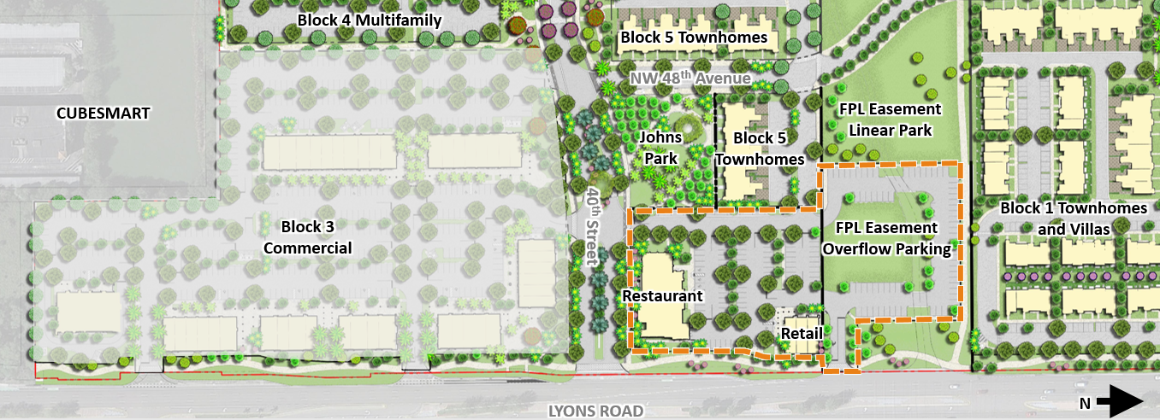
Commercial Development Along Lyons Road

Slide 2
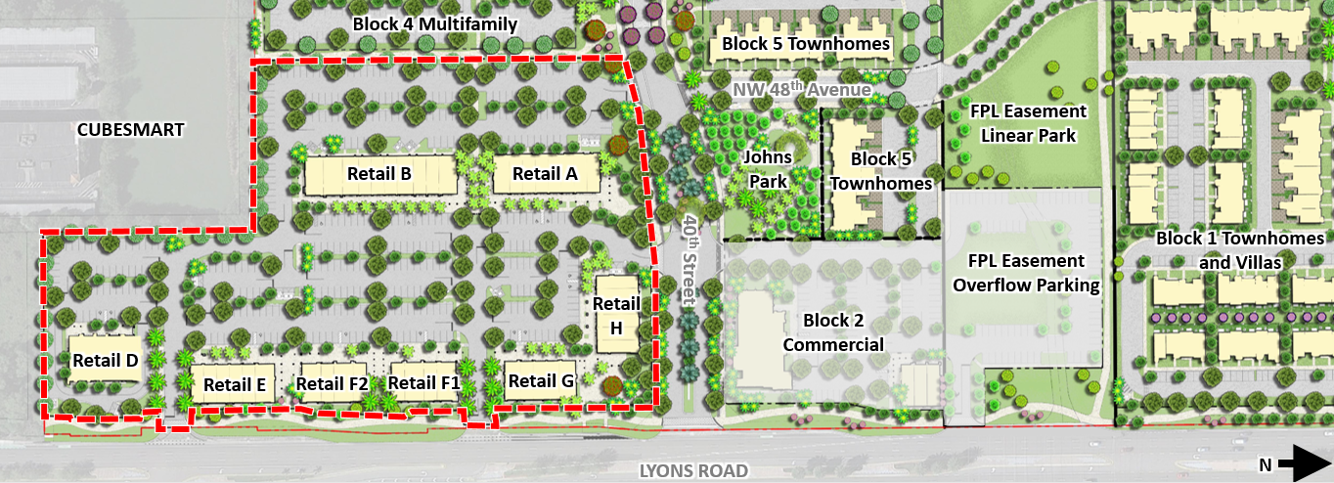

Slide 3
