Slide 1
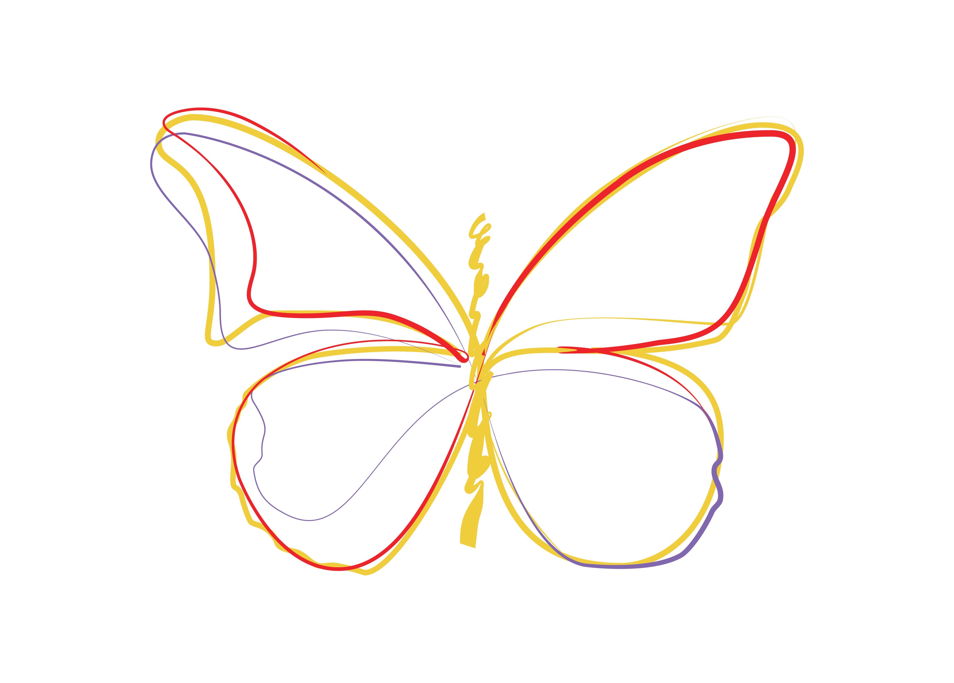
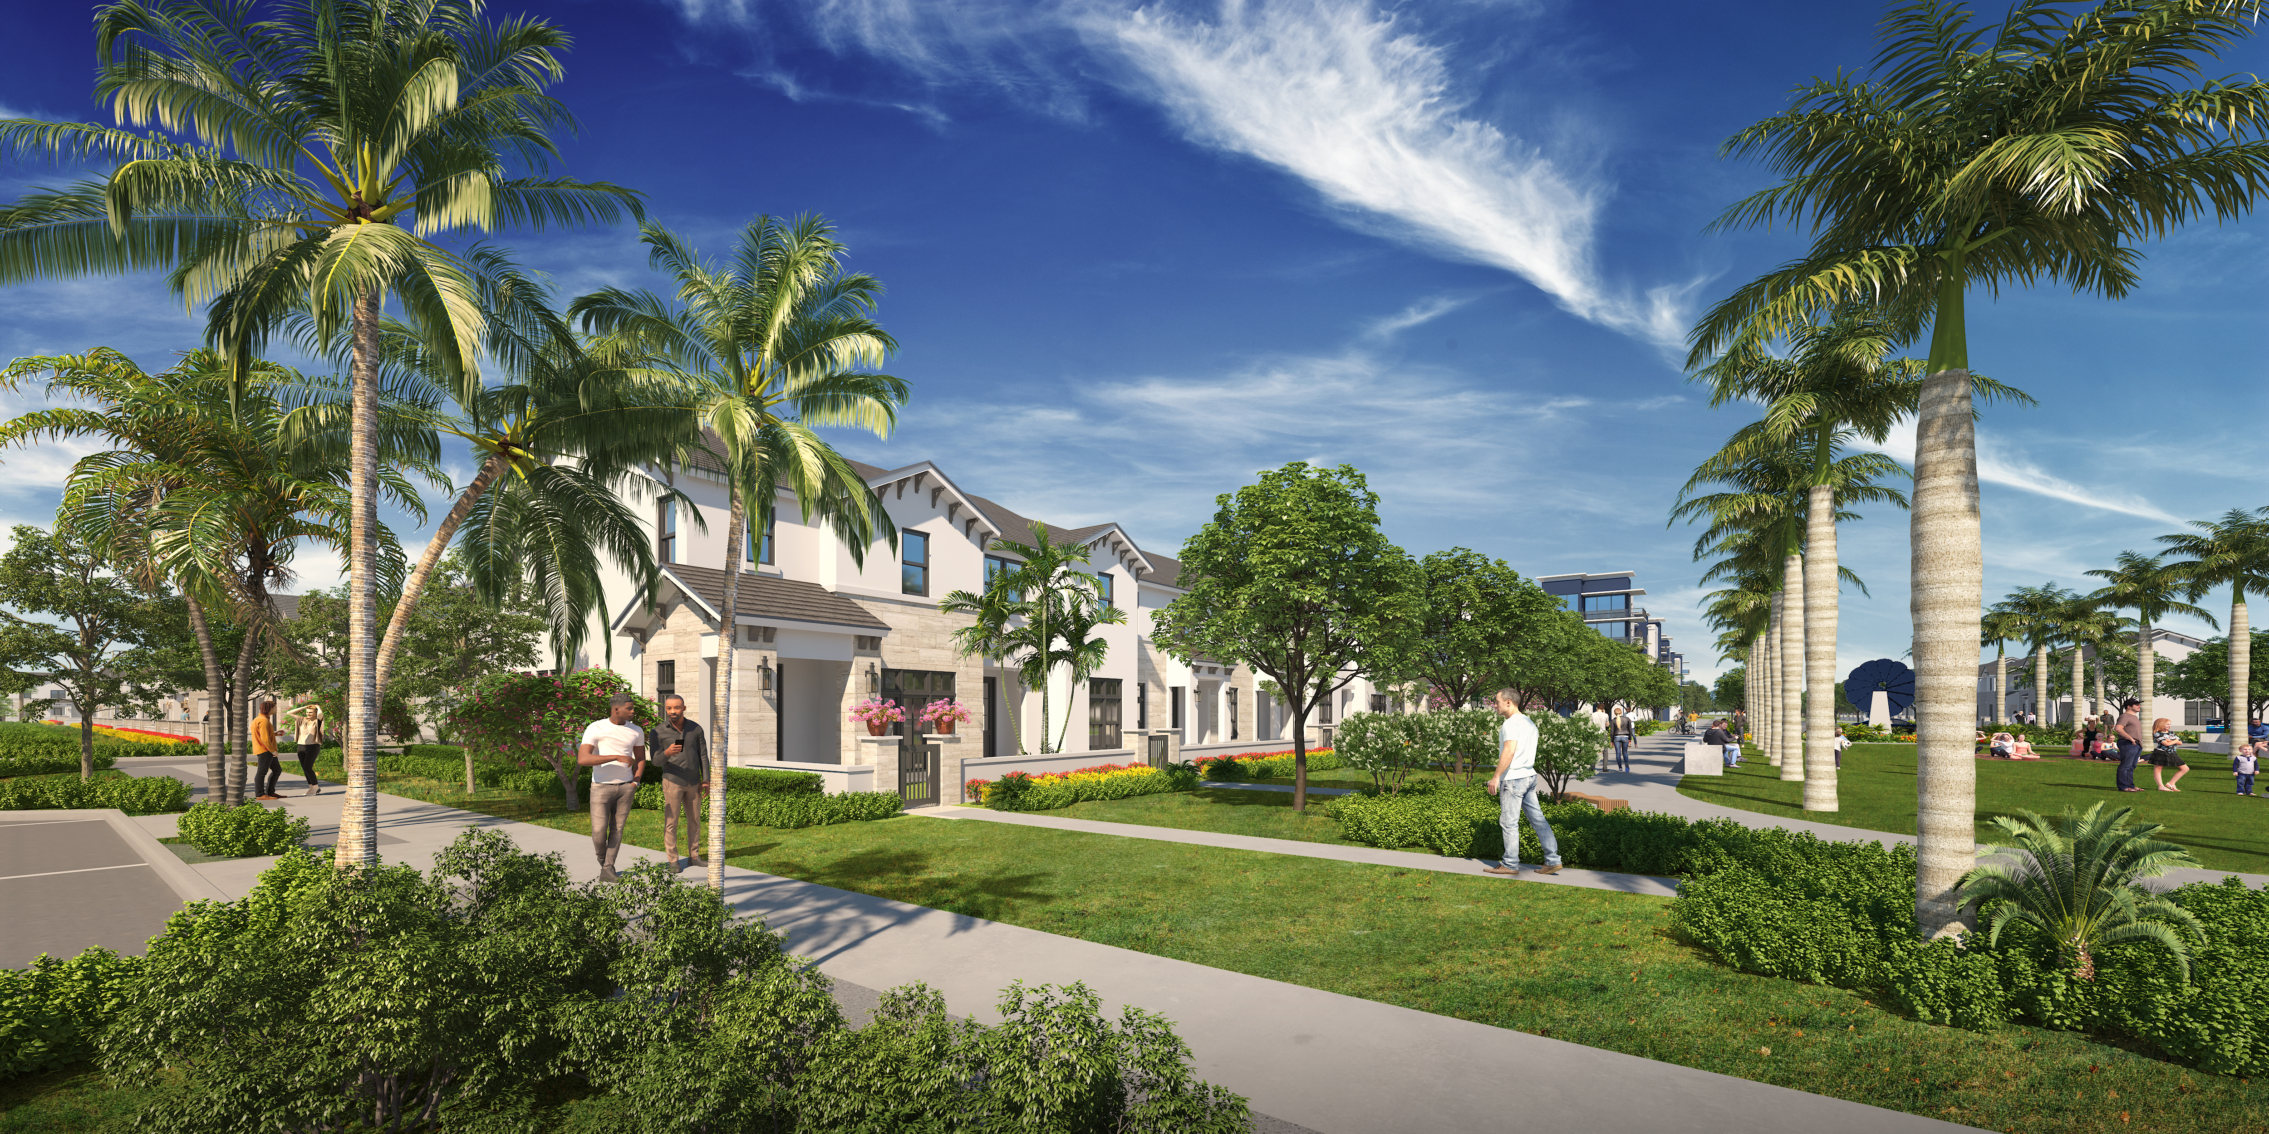
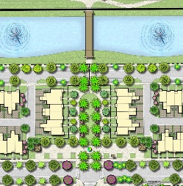
Block 5 with view of Main Pedestrian Plaza
40th Street

Slide 2
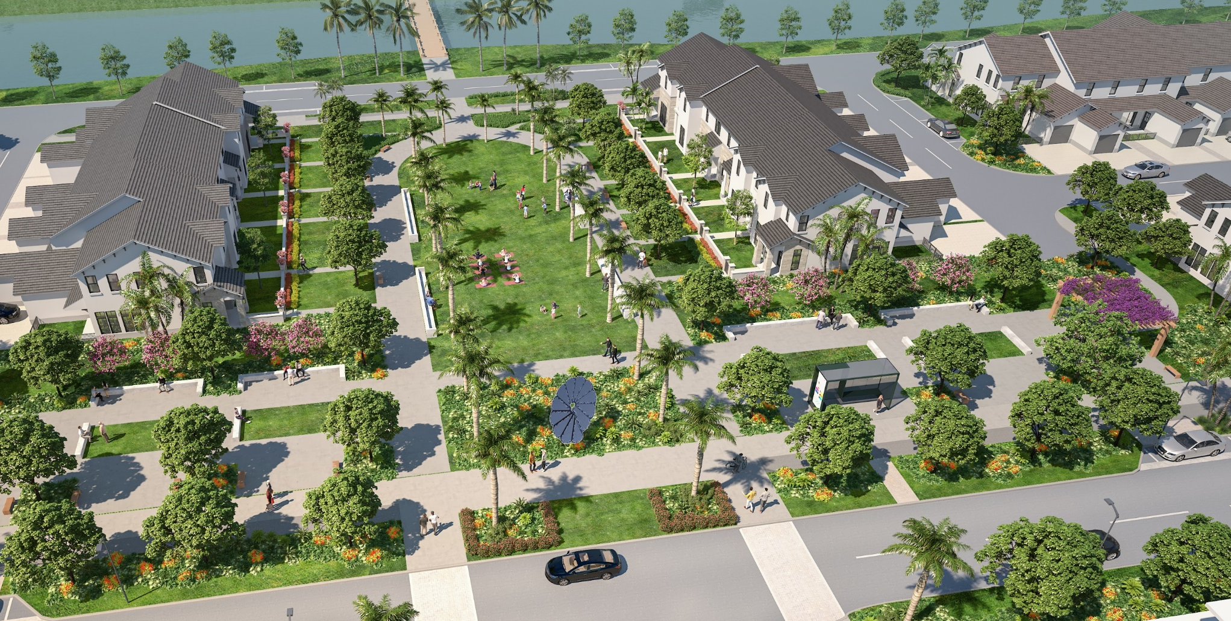
Blocks 5 & 6 with view of Main Pedestrian Plaza

